Slide 1
UI/UX Design
Lesson 4: UI/UX Design IV
Presented by Krystal Educational Platform

Slide 2
Lesson Outline
Learn about Penpot code mode function
Learn about Penpot comments mode function
Learn about how to export and import files in Penpot
Learn how to create a UX wireframe for the case practice

Slide 3
Contents
4.1
Penpot Code Mode
4.3
Import And Export Files
4.2
Penpot Comments Mode
4.4
Case Practice

Slide 4
Penpot Code Mode
4.1

Slide 5
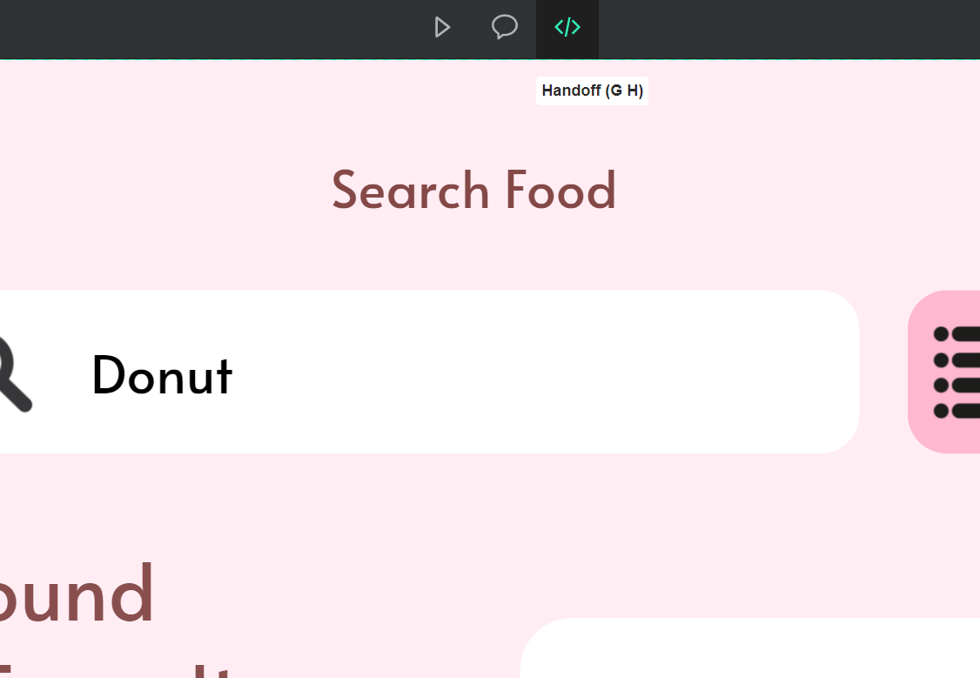
4.1 Penpot Code Mode
Press the view mode button first , and click on the handoff setting, this is the open the code mode button.

Slide 6
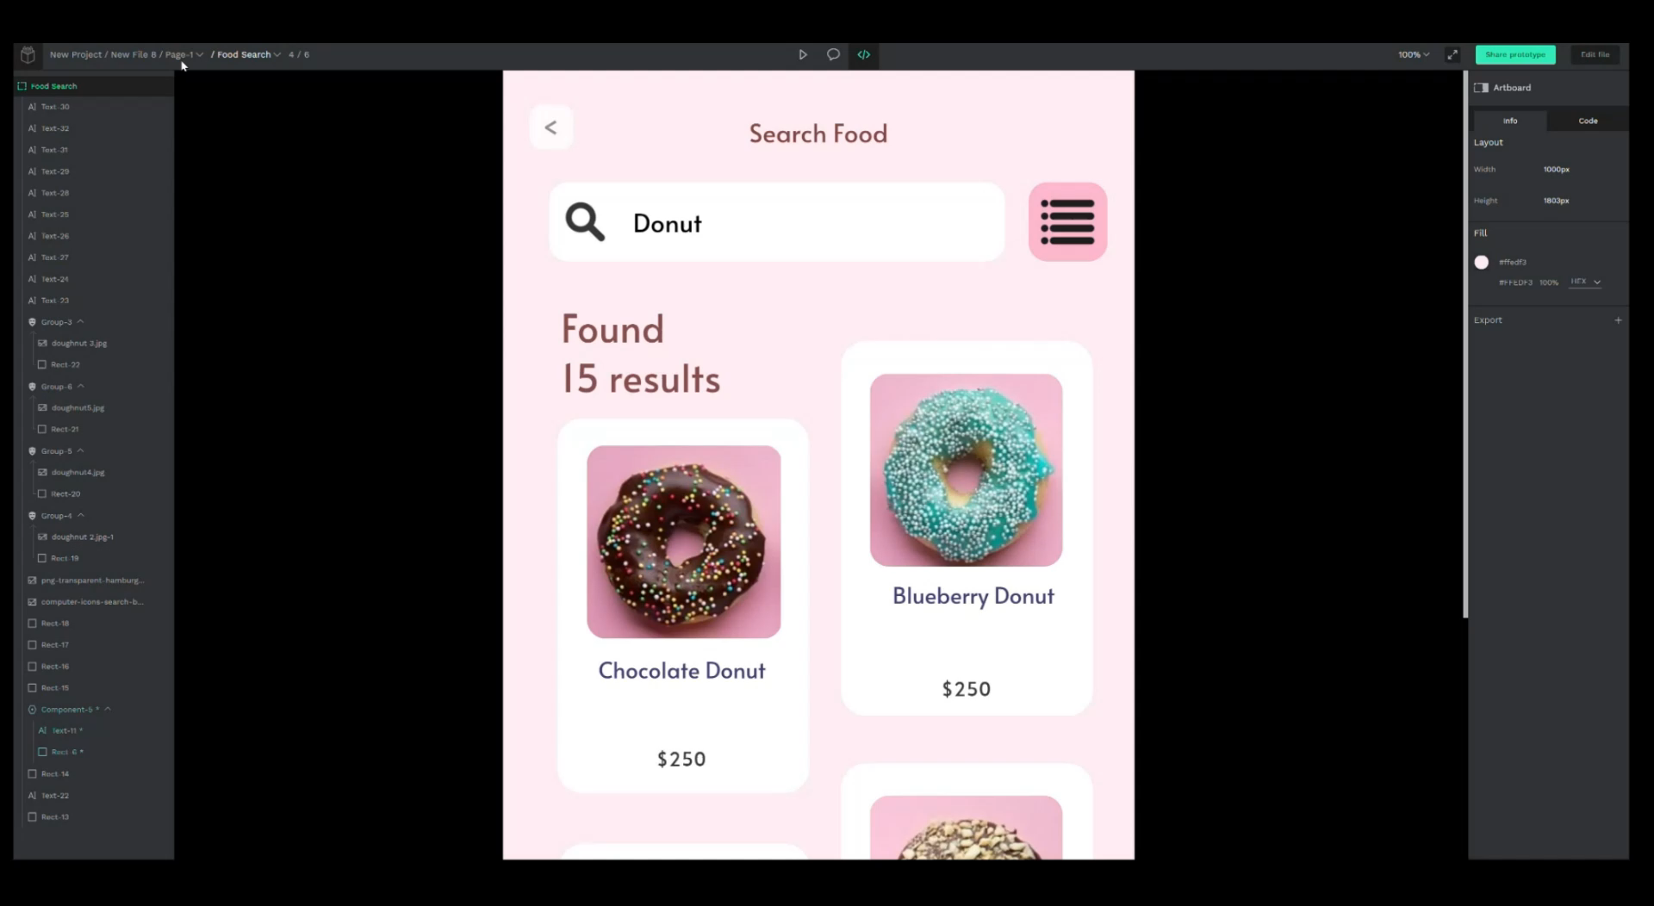
4.1 Penpot Code Mode
With the penpot code mode, you can inspect your designs to get specifications such as object properties, measurements and distances. You can also get code snippets for styles (currently CSS only but more coming) and SVG markup.

Slide 7
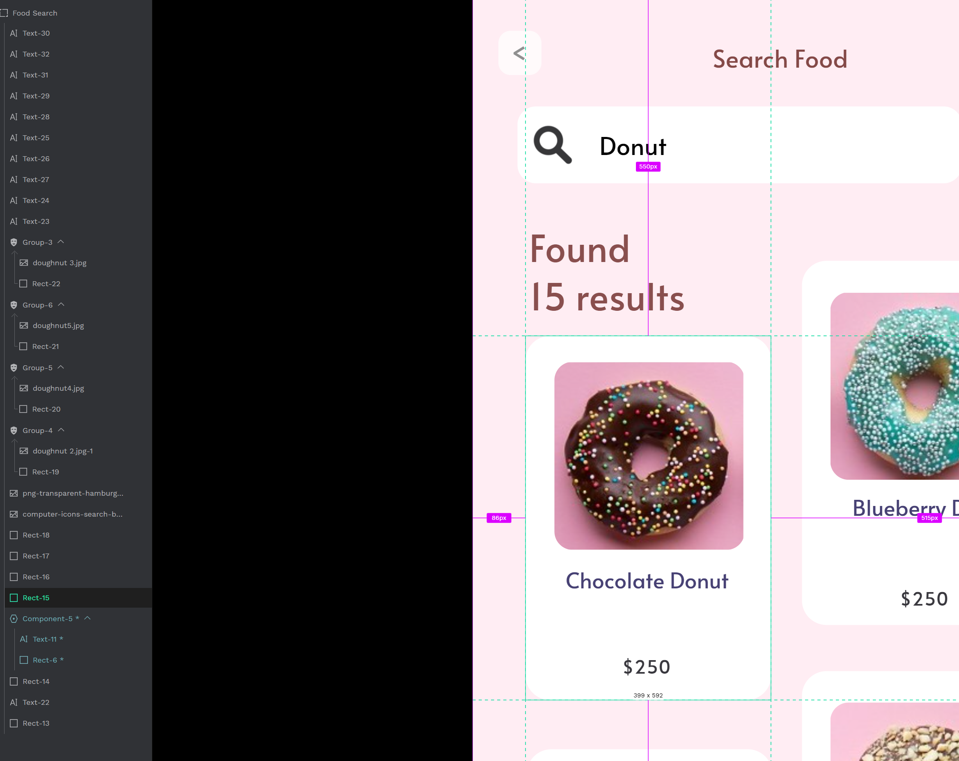
4.1 Penpot Code Mode
Inspect Designs
On the left sidebar you can see the layers tree. Select a layer to inspect it.

Slide 8
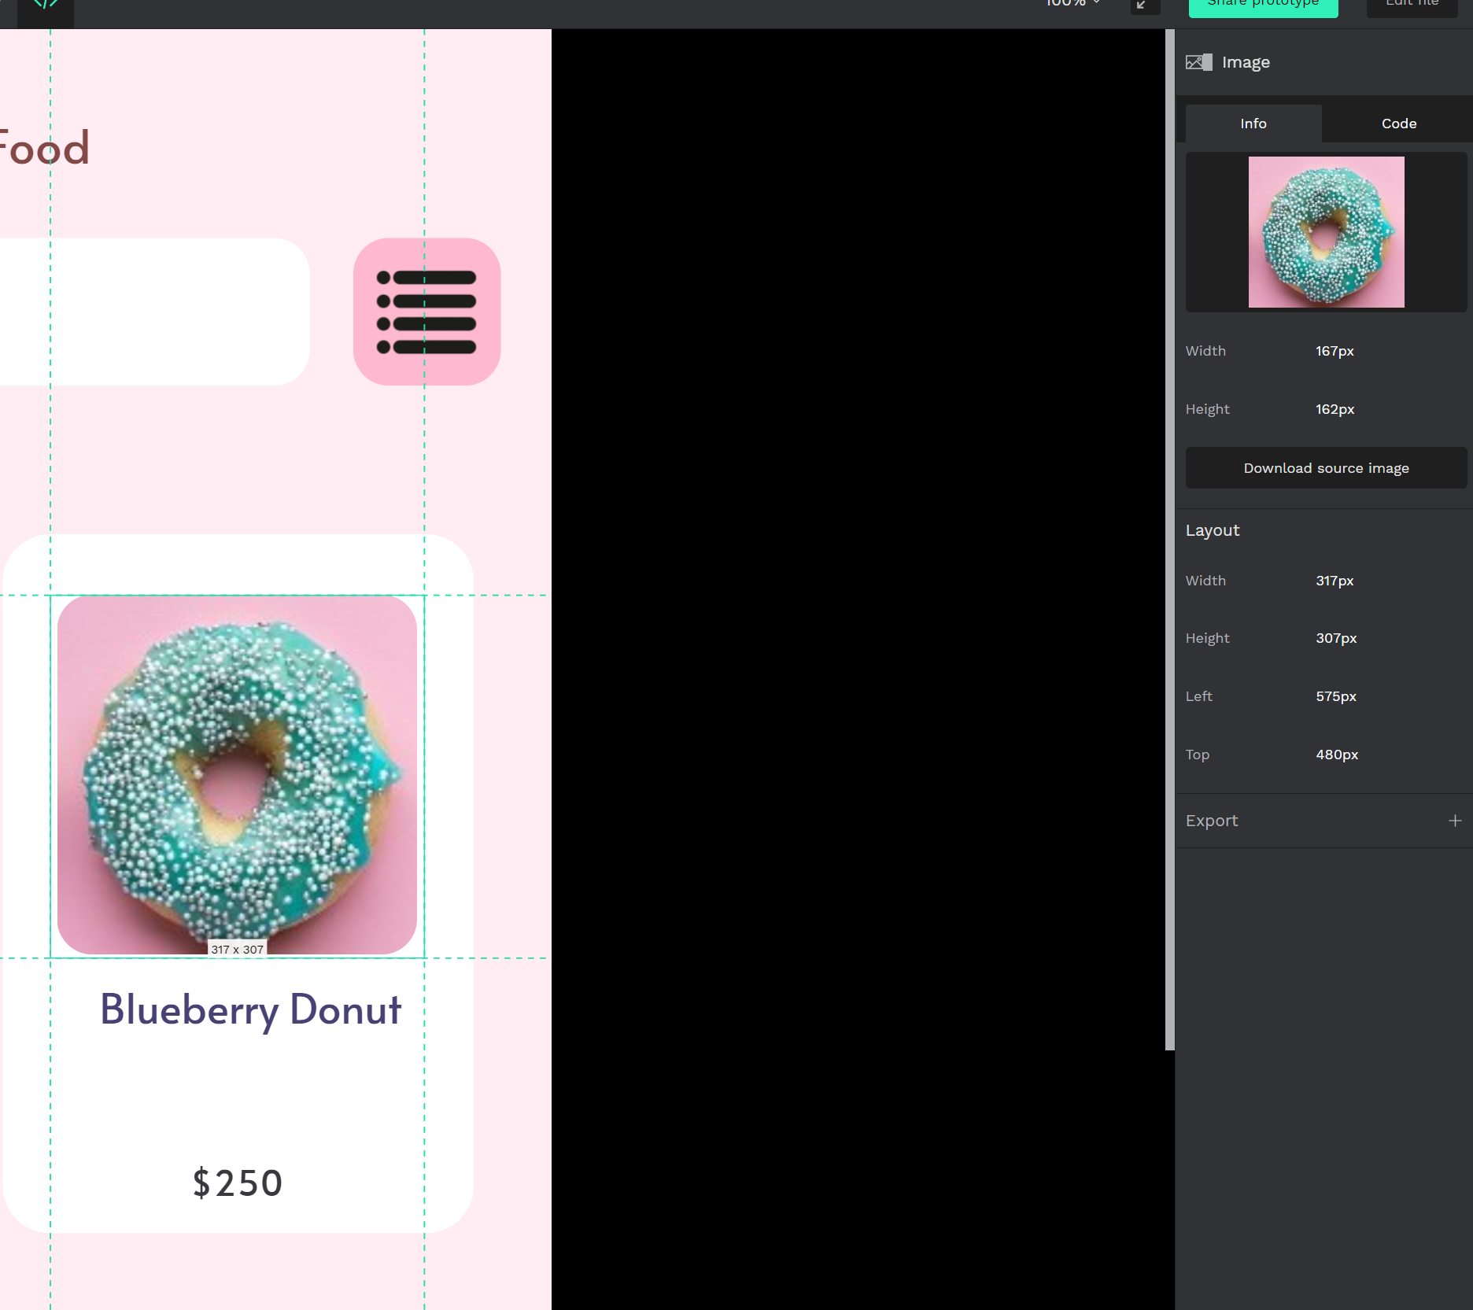
4.1 Penpot Code Mode
Inspect Designs
At the right sidebar: you can switch between Info and Code tabs to get design specifications or code.

Slide 9
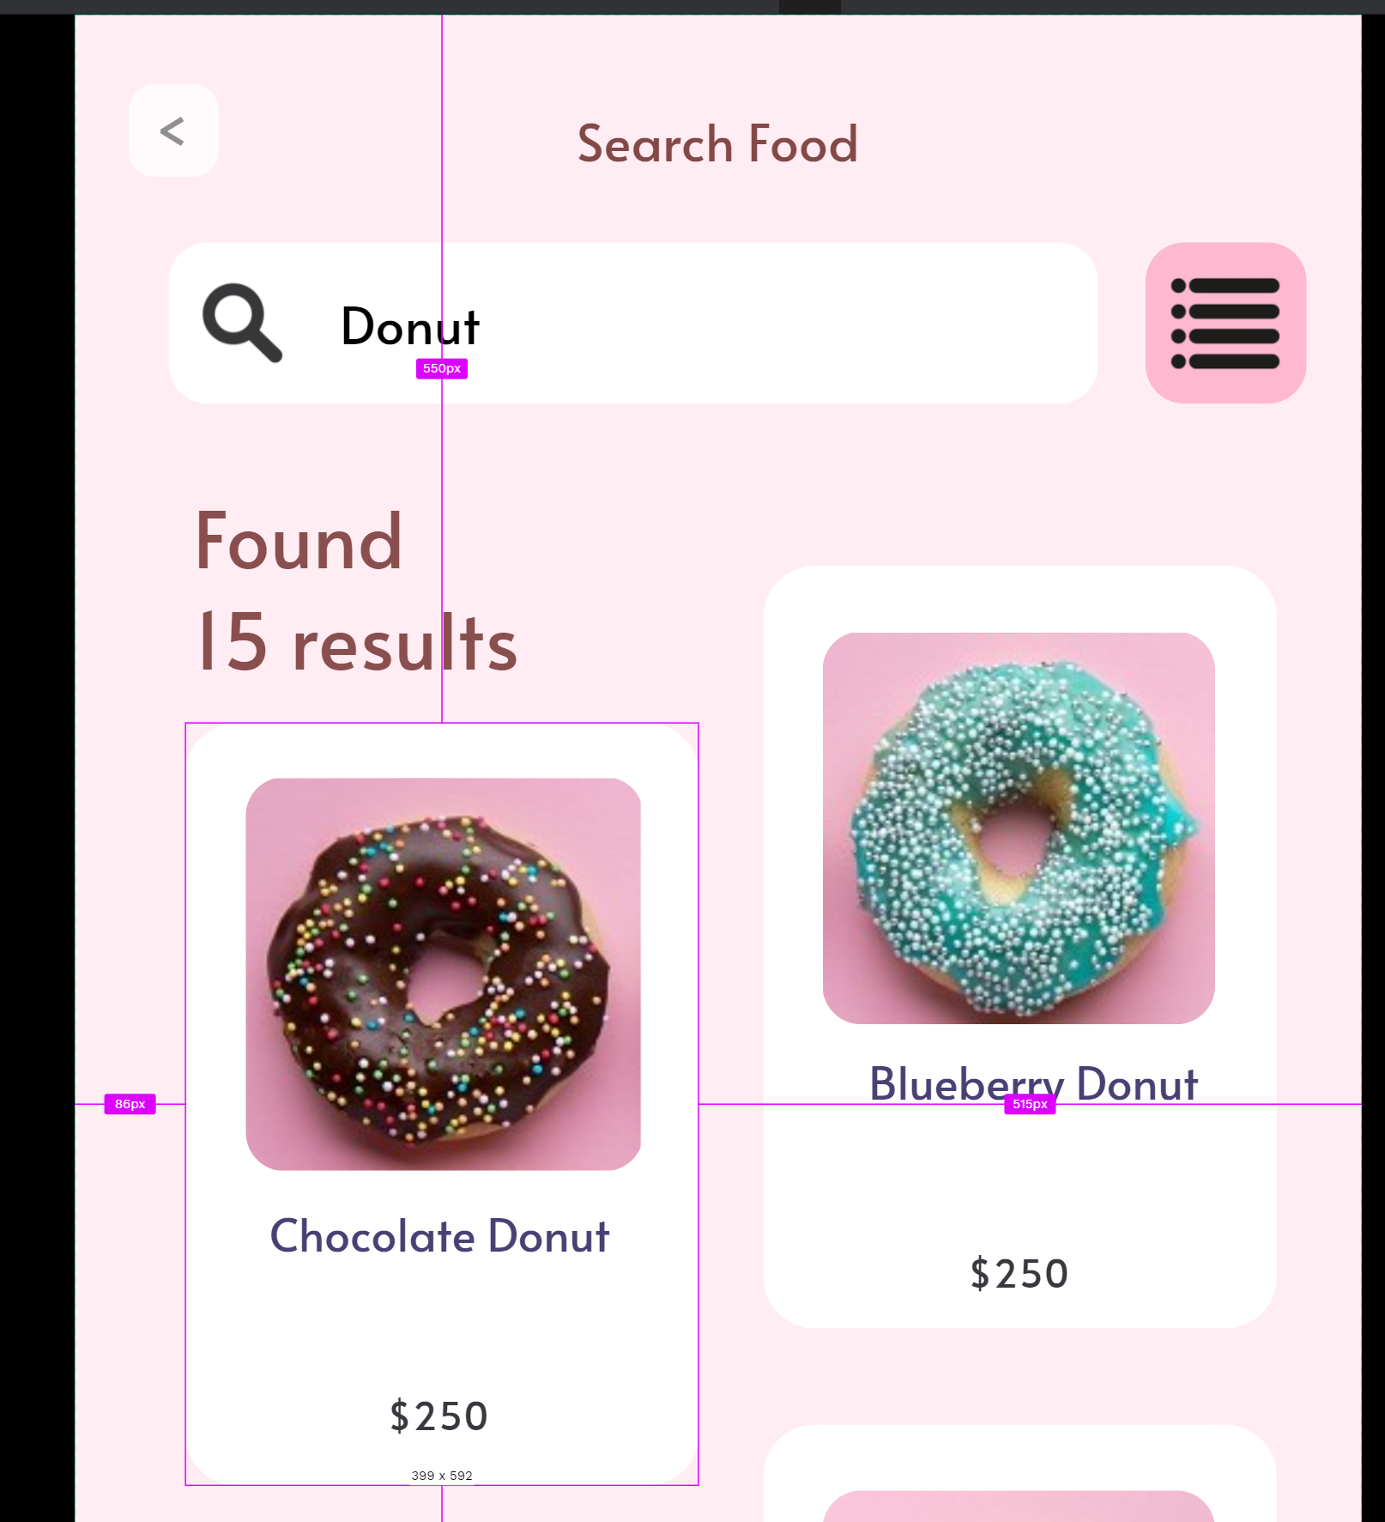
4.1 Penpot Code Mode
Distances and measurements
You can easily get measurements and distances between an object and other objects and artboard edges.

Slide 10
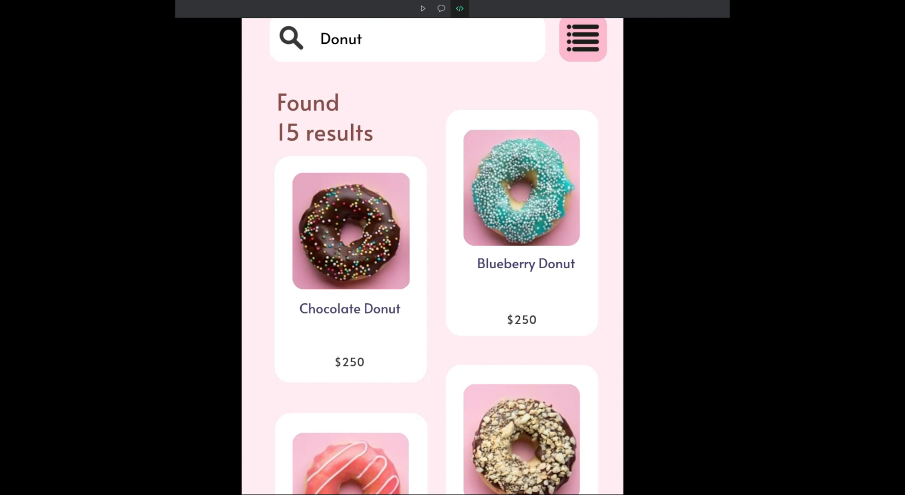
4.1 Penpot Code Mode
To get distances:
Click on an object or select it at the layers panel.
Hover other objects to see the distances between them and the selected one.
Hover a free space at the artboard or the area around it to get the distance from the object to the artboard edges.

Slide 11
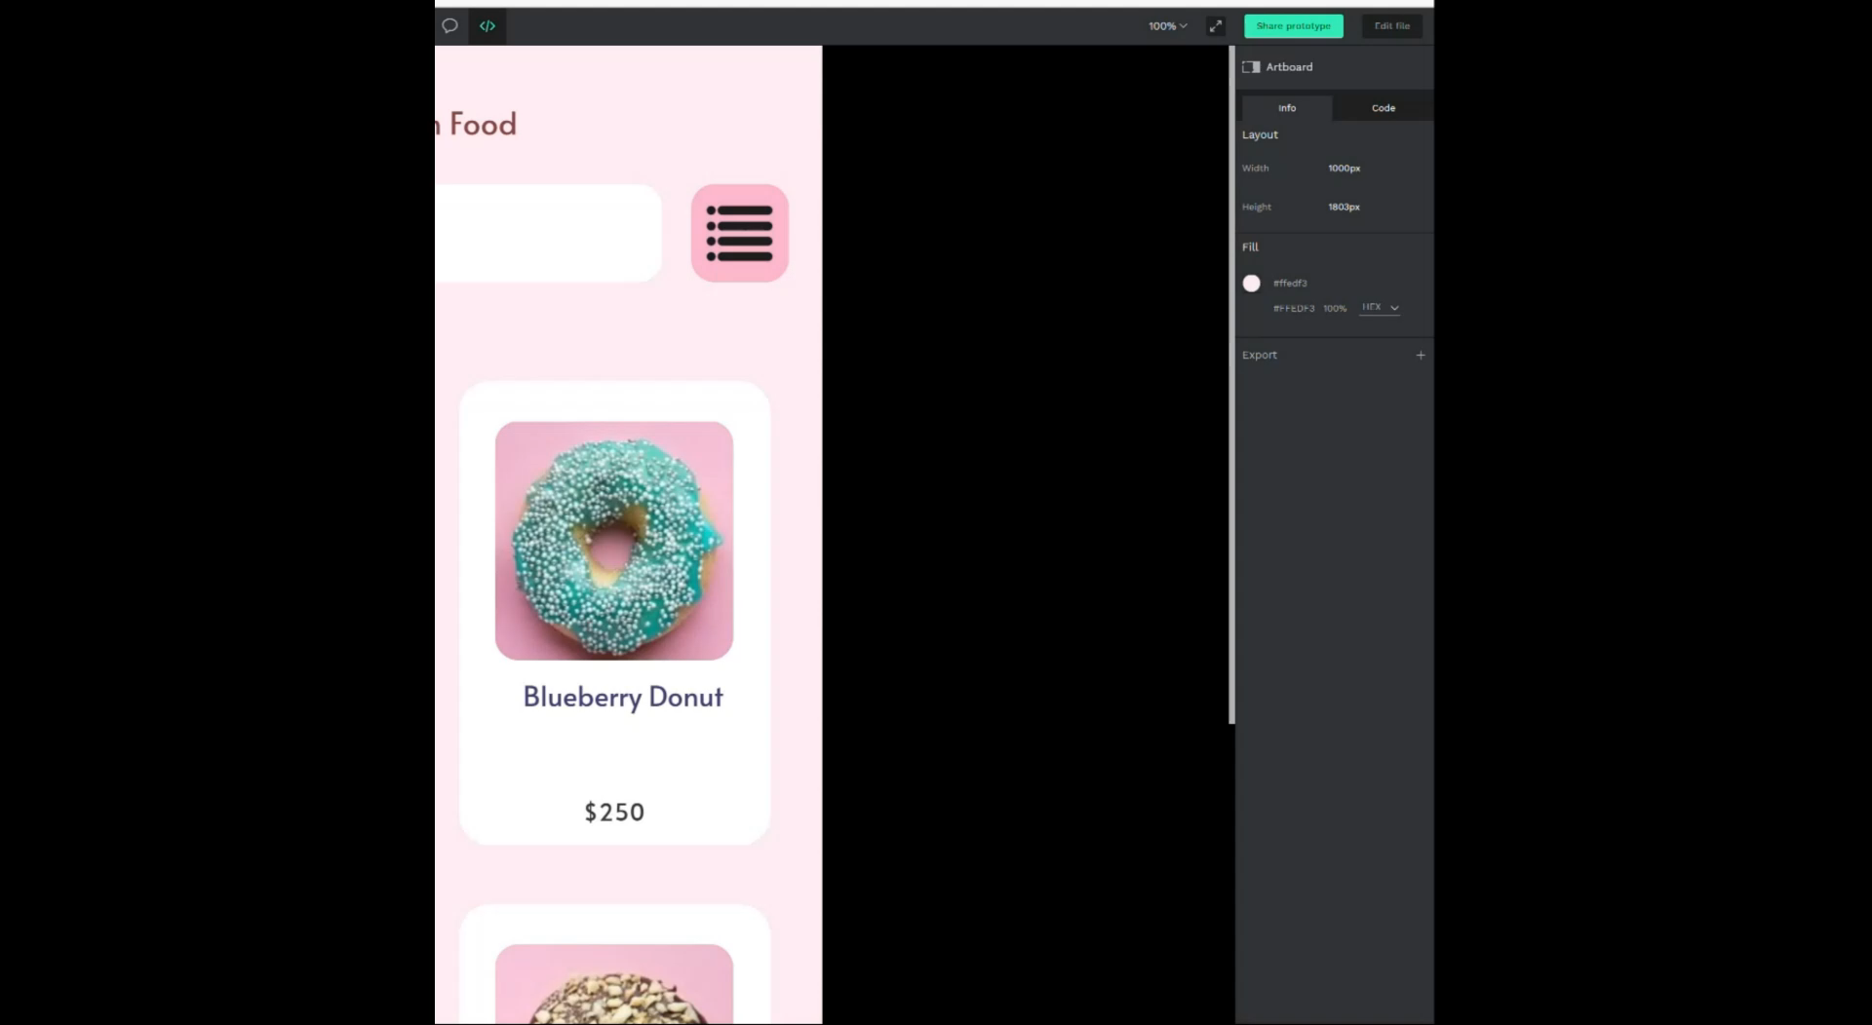
4.1 Penpot Code Mode
Info panel
At the info panel, you can see specifications about the style and content of an object. Different types of objects can have different sets of properties.

Slide 12
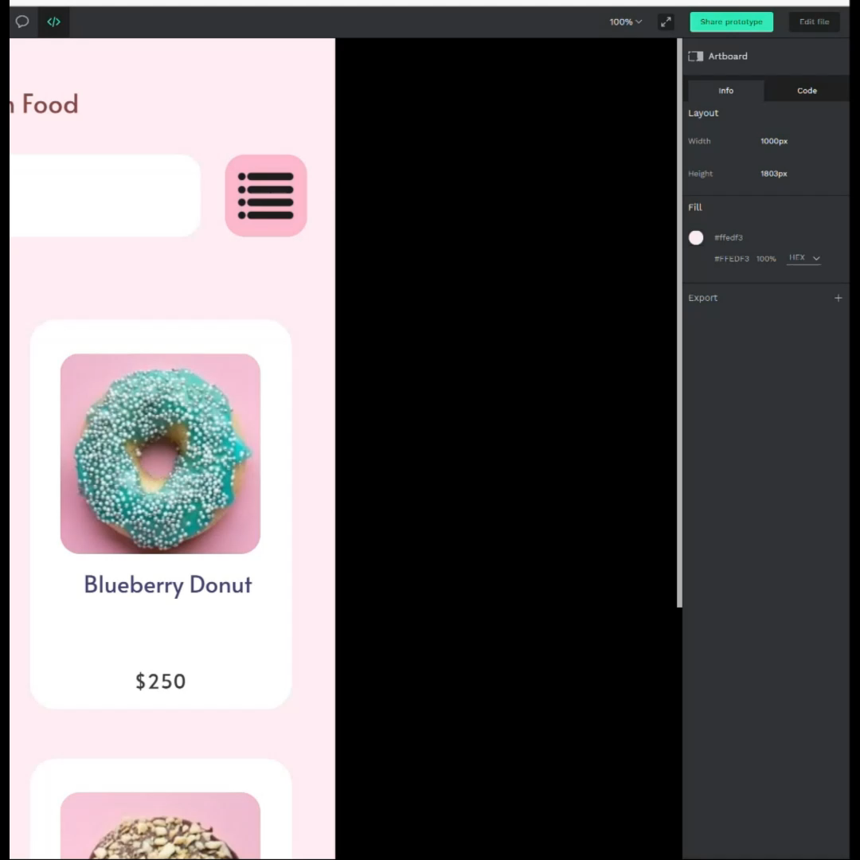
4.1 Penpot Code Mode
Info panel
Copy properties
we can copy property values individually or full sections of them pressing the copy buttons that are shown at the right when hovering. For example, we could copy all the layout properties or only the width.

Slide 13
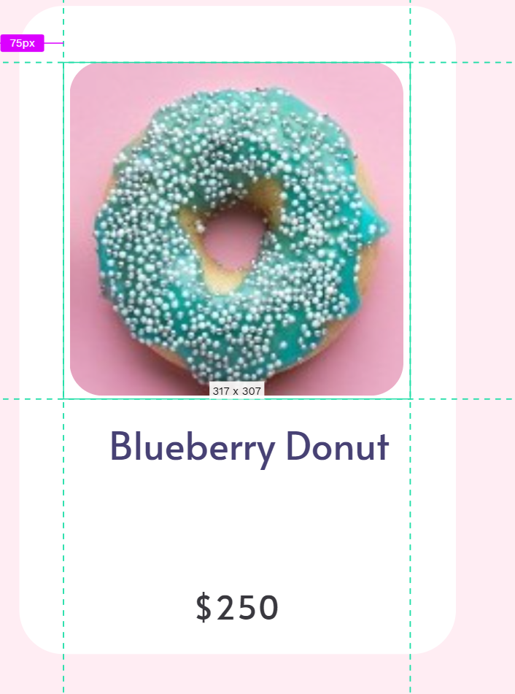
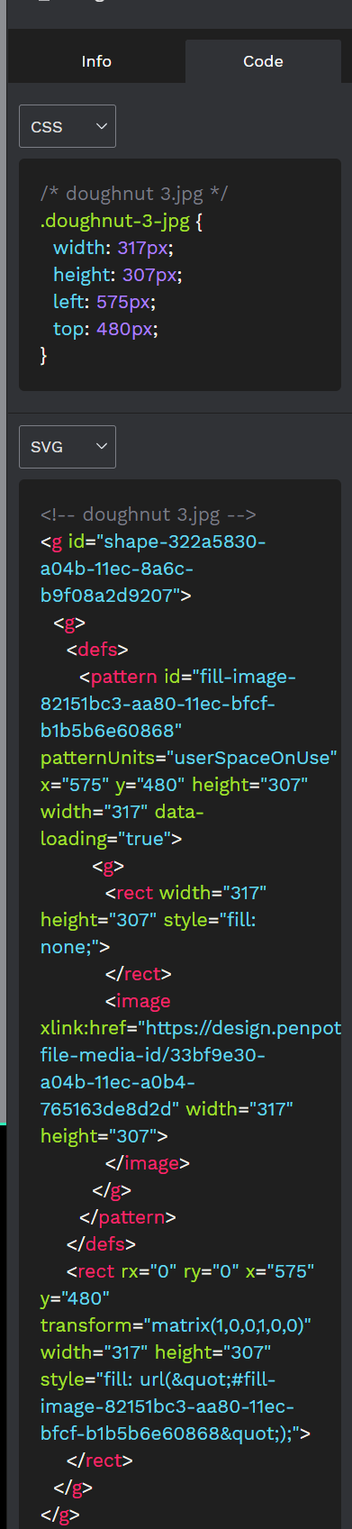
4.1 Penpot Code Mode
Code panel
Press the code tab to get actual code snippets. Select an object to get ready to use code for styles (currently CSS only but more coming) and SVG markup.

Slide 14
Penpot Comments Mode
4.2

Slide 15
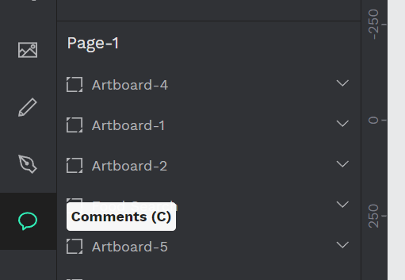
4.2 Penpot Comments Mode
penpot allows leaving the comments to get and providing feedback right over the designs and prototypes.

Slide 16
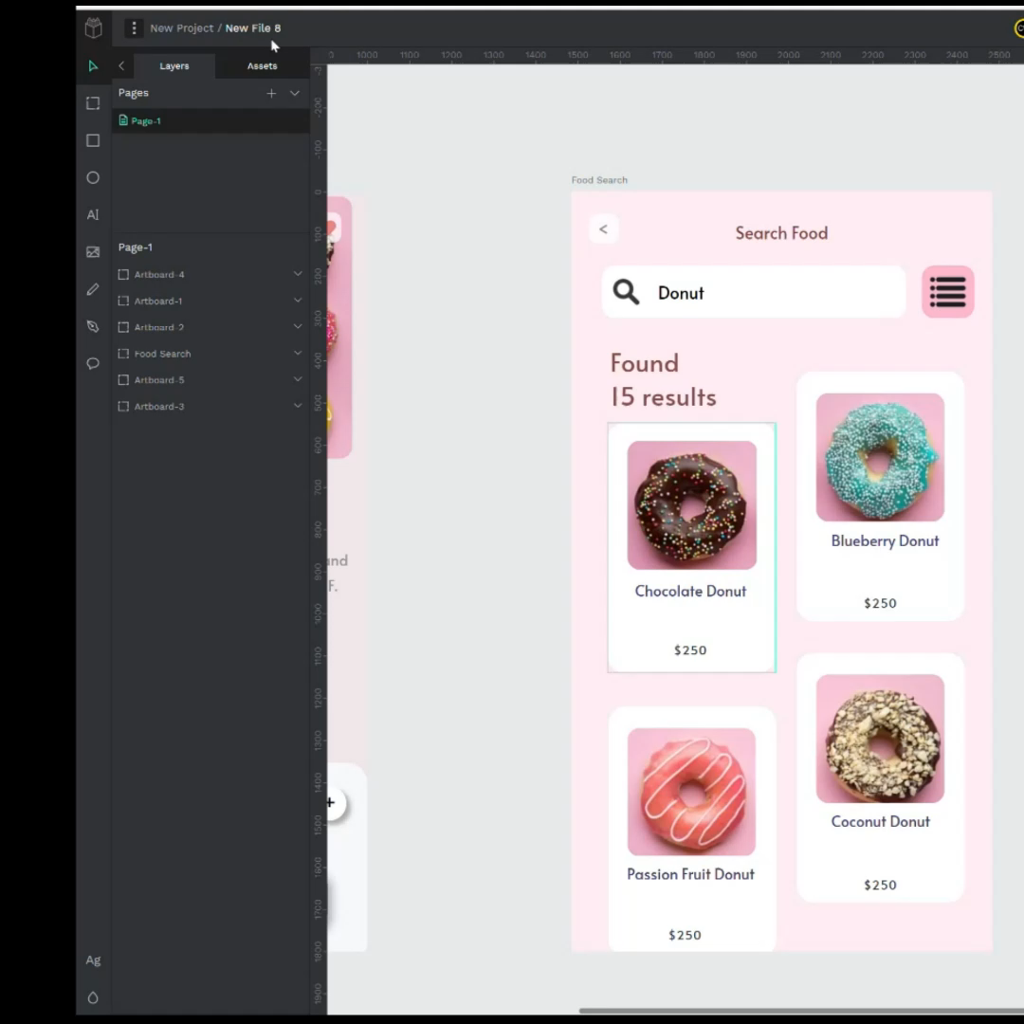
4.2 Penpot Comments Mode
Adding comments
At the workspace, activate the comment tool by clicking the comment icon in the toolbar or pressing the C key.
Click a place at the viewport where you’d like to leave the comment. If you want the comment to appear at the view mode leave the comment inside an artboard.
Write your comment at the text box.
Press Post to leave the comment or Cancel to not do it.

Slide 17
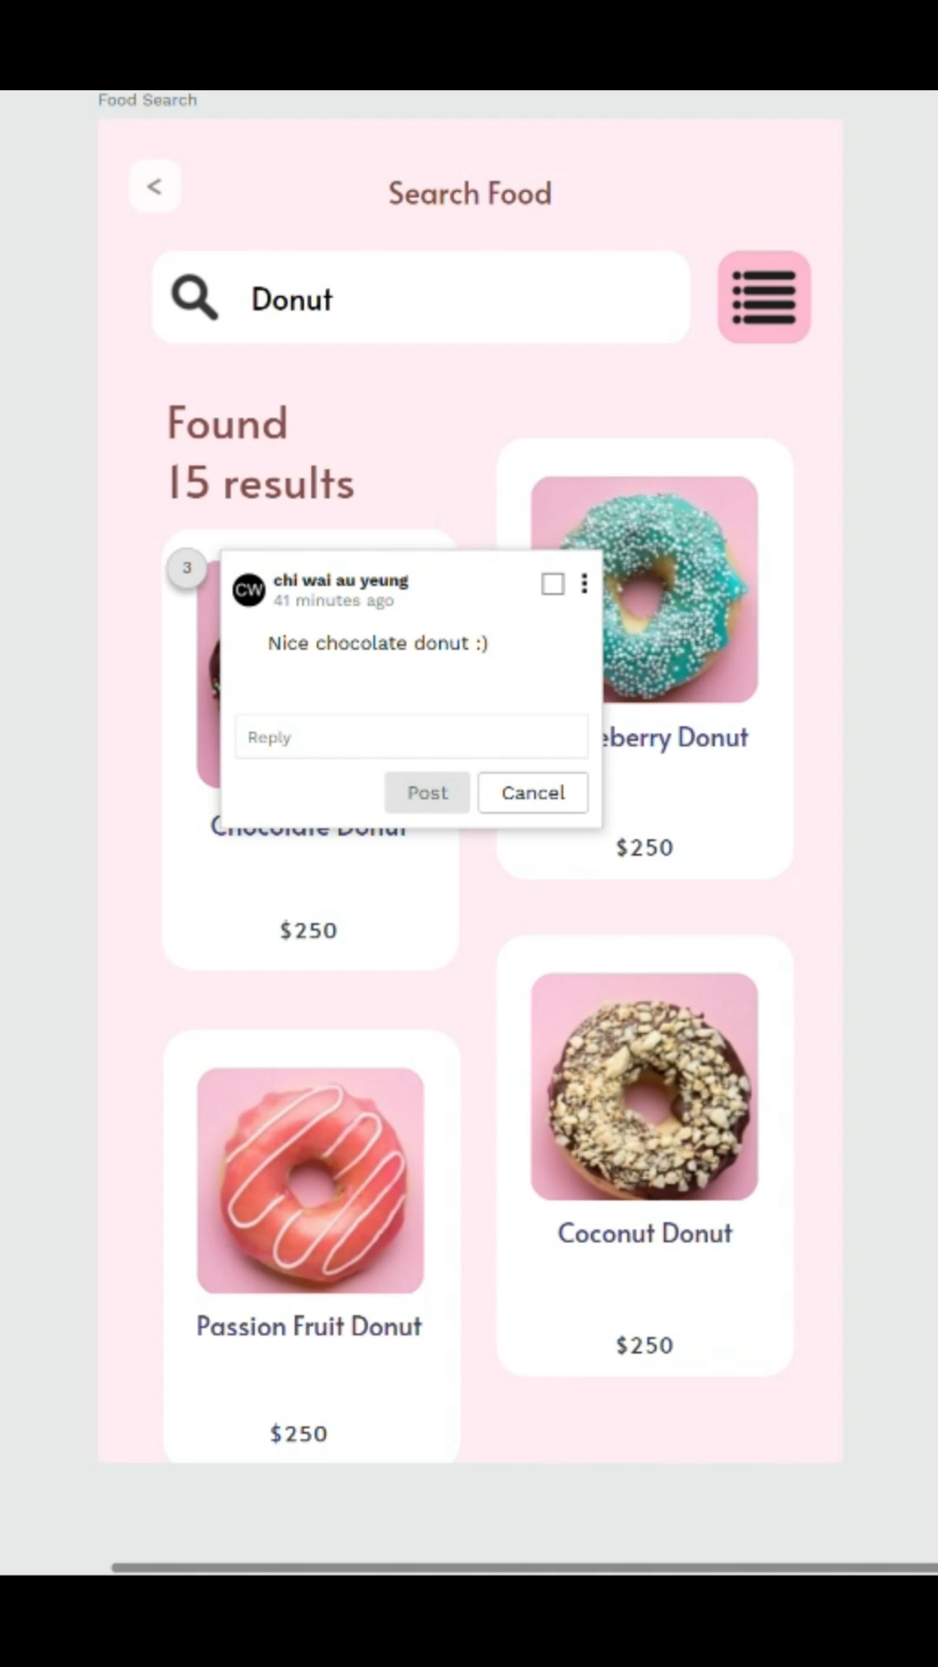
4.2 Penpot Comments Mode
reply a comment
Open a comment by clicking at its bubble (a circled number).
Write your comment at the text box at the end of the comment popup.
Press Post to leave the comment or Cancel to not do it.

Slide 18
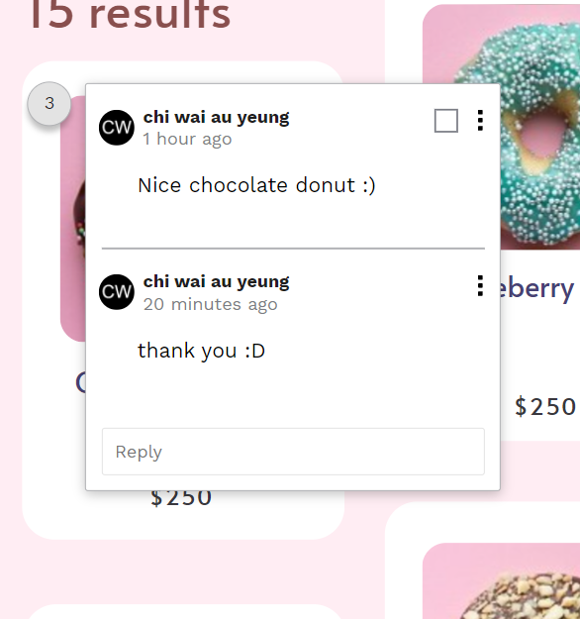
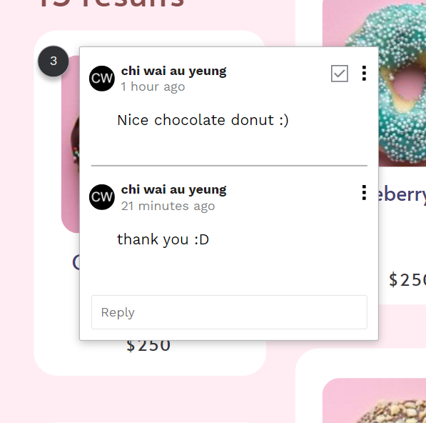
4.2 Penpot Comments Mode
Mark threads as read
Mark a thread as read using the checkbox at the comment box to make it disappear from the comments notifications at the dashboard.

Slide 19
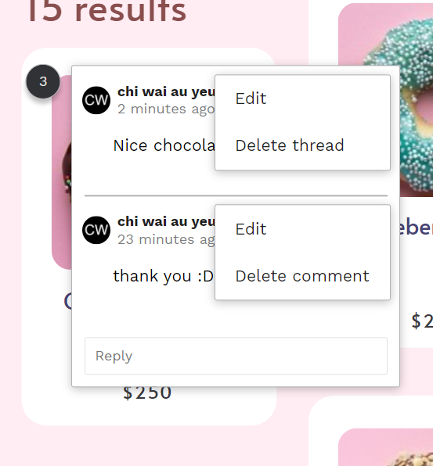
4.2 Penpot Comments Mode
Edit and remove comments
At the top right of the comment popup you can find options to edit or delete comments.

Slide 20
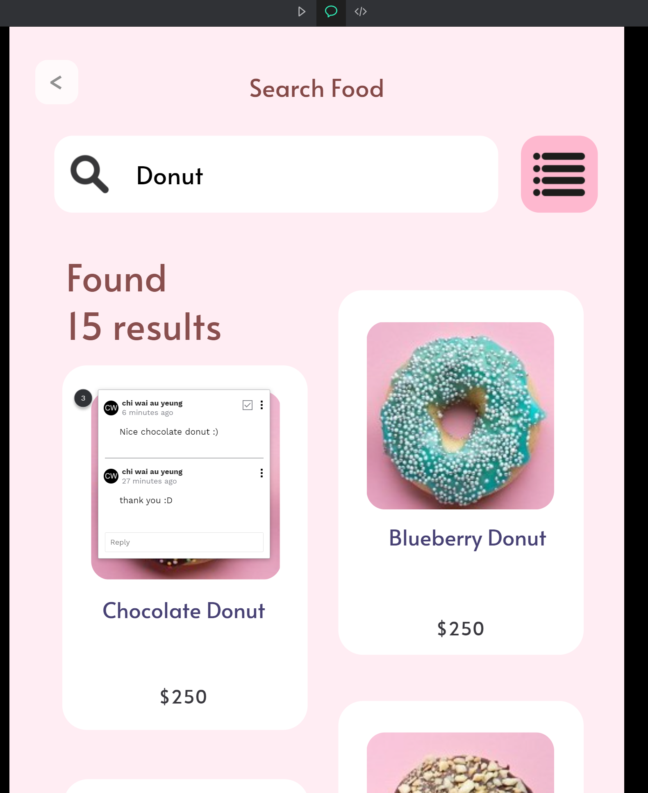
4.2 Penpot Comments Mode
Comments at the View mode
Pressing the comments icon at the top navbar. To check out the comments.

Slide 21
Import And Export Files
4.3

Slide 22
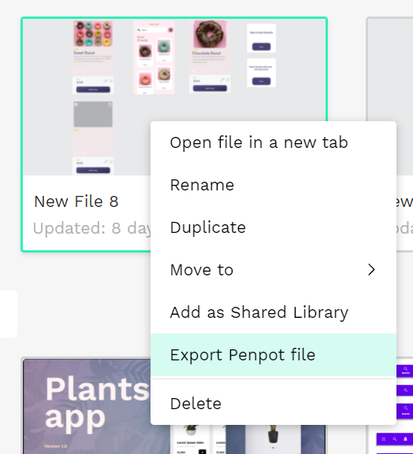
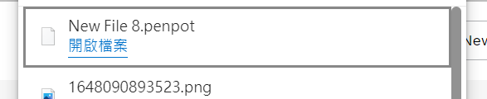
4.3 Import and export files
Export Penpot files
You can export Penpot files to your computer and import them from your computer to your projects.
Exporting files is useful If you want to share Penpot files with a user that does not belong to one of your teams or you want to have a backup of your files outside penpot.app. penpot file will be downloaded to your computer.

Slide 23
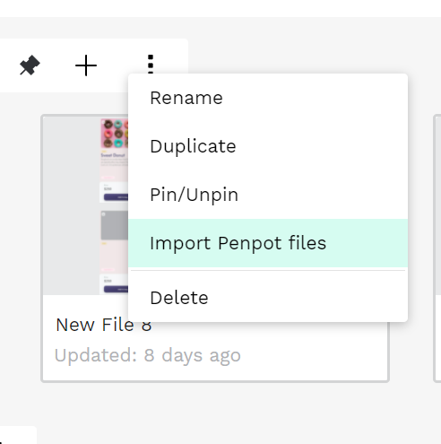
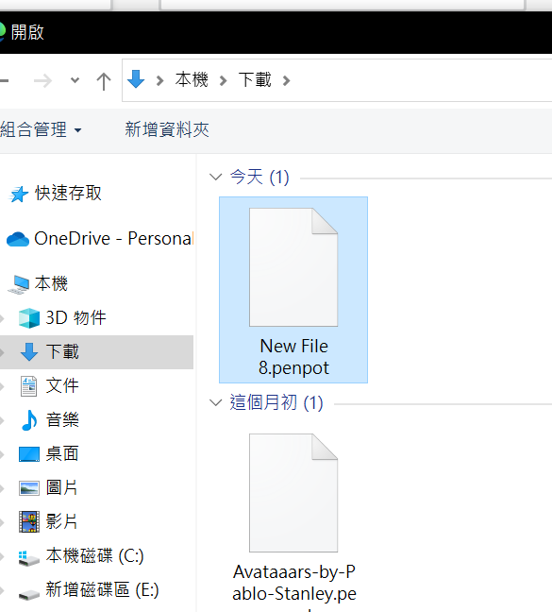
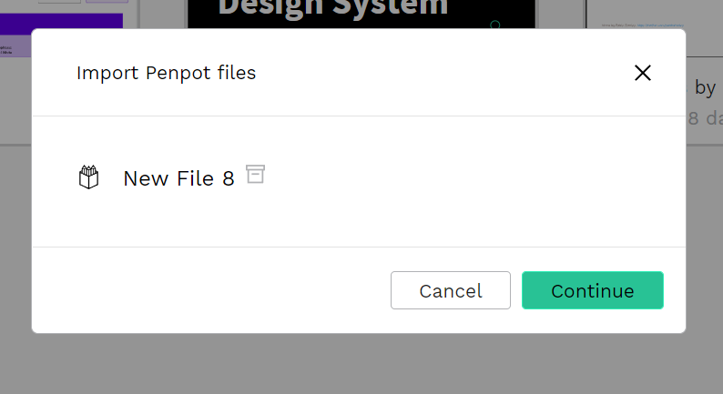
4.3 Import and export files
Import Penpot files
The import option is at the projects menu. Press “Import files” and then select one or more .penpot files to import.

Slide 24
Case Practice (I)
4.4

Slide 25
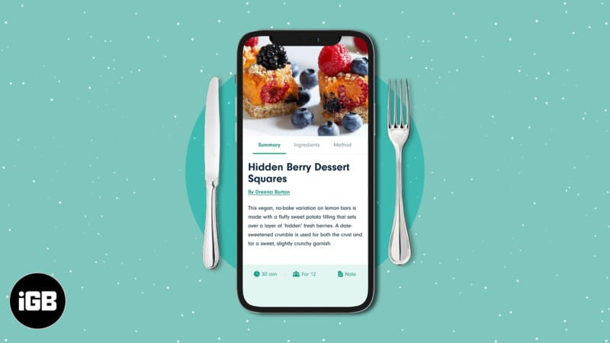
4.4 Case Practice (I)
Now we are going to make a mobile APP UI/UX, which is a cooking recipe APP. The content includes landing page, log in, registration, homepage, category, selection, recipe list, Profile Page, and recipe page.

Slide 26
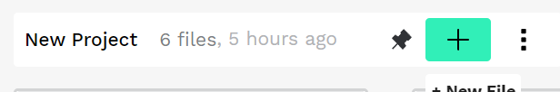
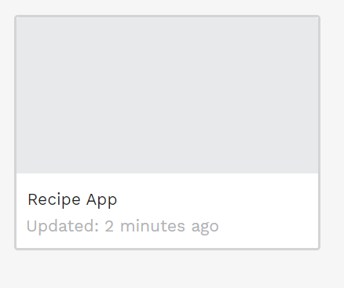
4.4 Case Practice (I)
Step1: Frist creates a new file in penpot, Change the name to make the file easier to handle. The file can be a recipe app, food recipe, or any recipe name.

Slide 27
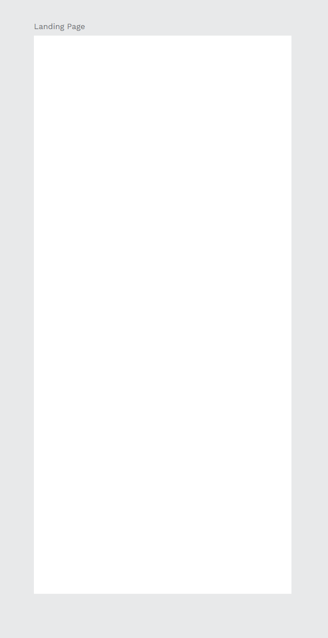
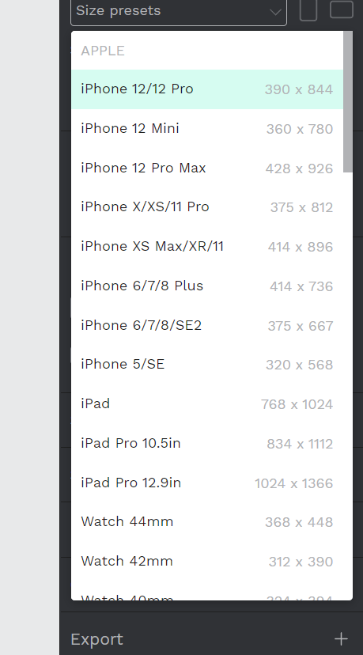
4.4 Case Practice (I)
Step2: Create an artboard and change the name to a landing page, the size in presets has a default size, we choose iPhone 12/12 pro for the practice.

Slide 28
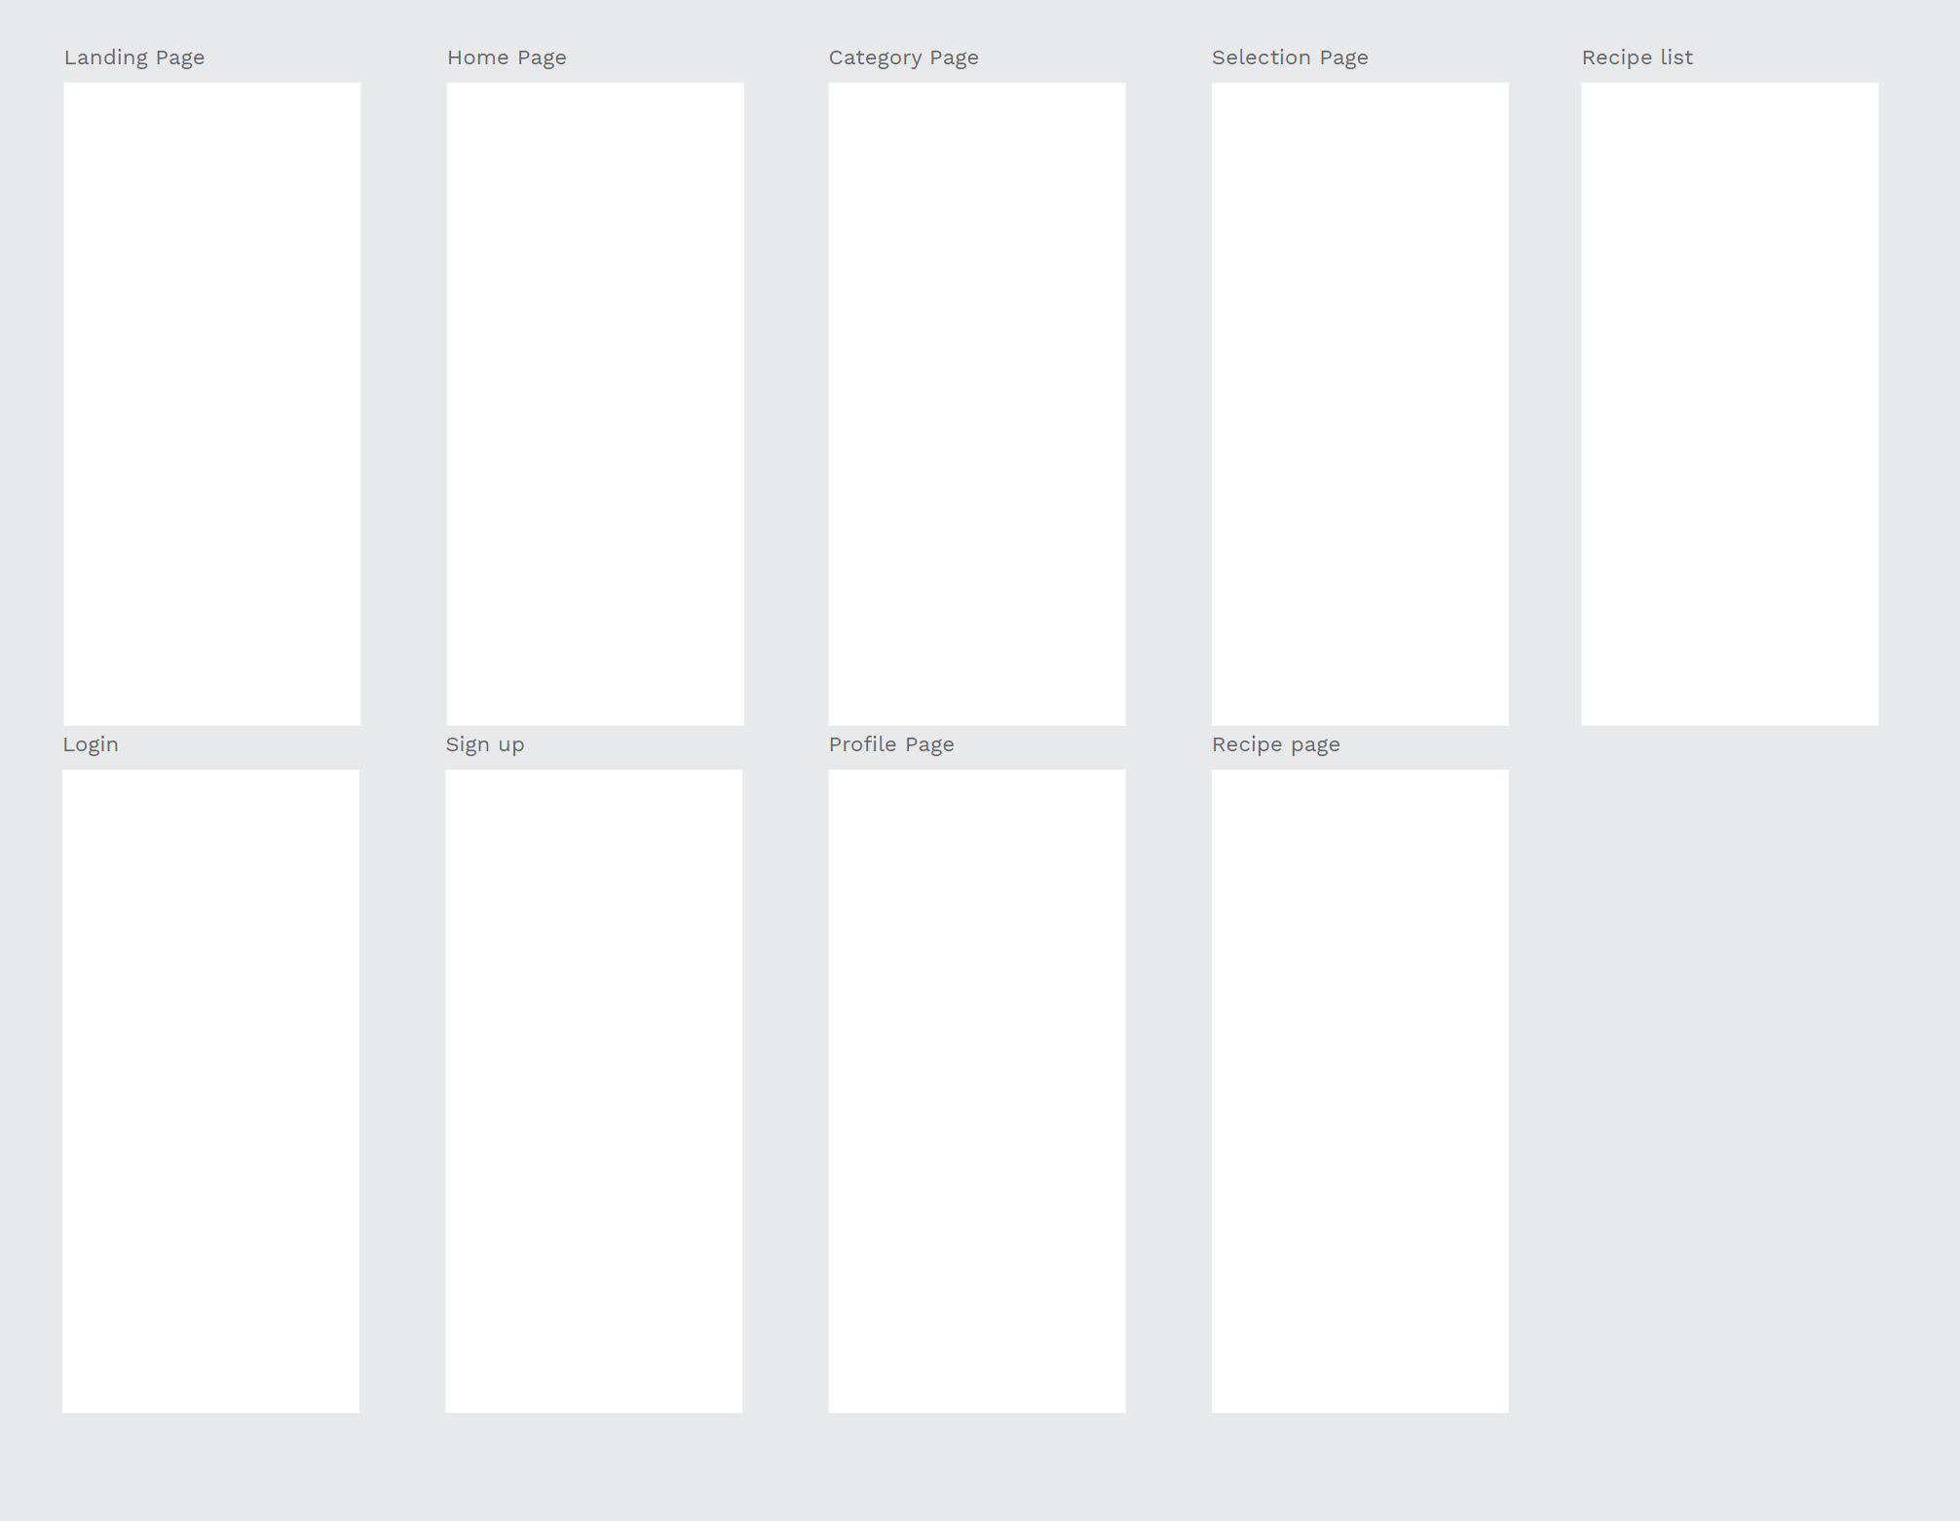
4.4 Case Practice (I)
Landing Page
Home Page
Category Page
Selection Page
Recipe-List
Step3: Copy the original landing page artboard, paste the other 9 artboards, change the name of the rest of the artboards, match the artboard close together and match the positions. so that it will not confuse when dealing with different artboards later.
Login Page
Sign up Page
Profile Page
Recipe Page

Slide 29
4.4 Case Practice (I)
Landing Page
Home Page
Category Page
Selection Page
Recipe-List
Step4: let's use all the artboard to create wireframes, the wireframes will make us easily understand the app flow how is going.
Login Page
Sign up Page
Profile Page
Recipe Page

Slide 30
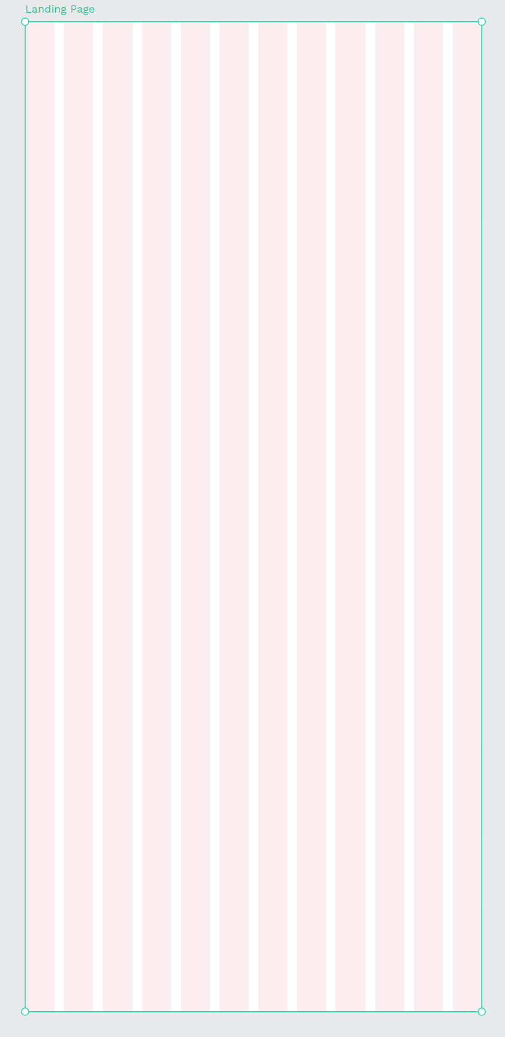
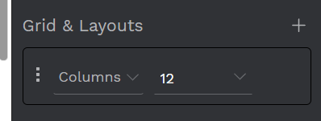
4.4 Case Practice (I)
Step5: Choose the Landing page, press the Grid & Layouts button, and set it to columns, is for the button and the text adjust the position.

Slide 31
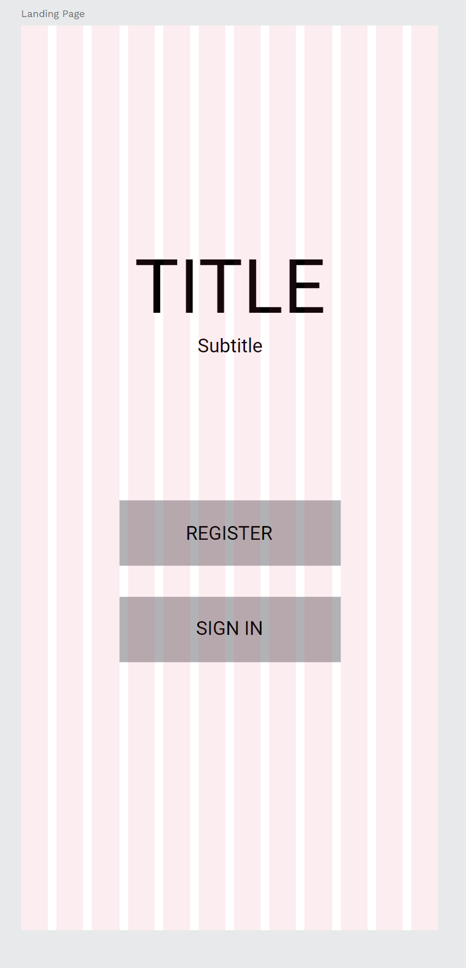
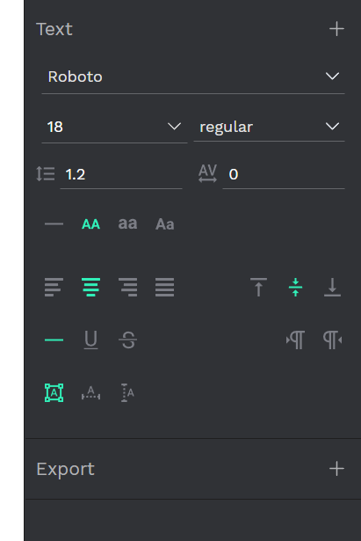
4.4 Case Practice (I)
Step6: After that we use the rectangle tool to create two buttons, one is resister and another one sign-in button. Using the columns to help us to match the button and button position.
Then give the text inside the button, the text properties are Roboto font, size around 16-18 regular, and set the position is align center and align middle, to make the text Set in the center.

Slide 32
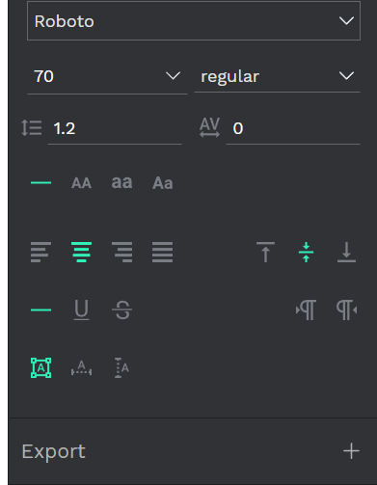
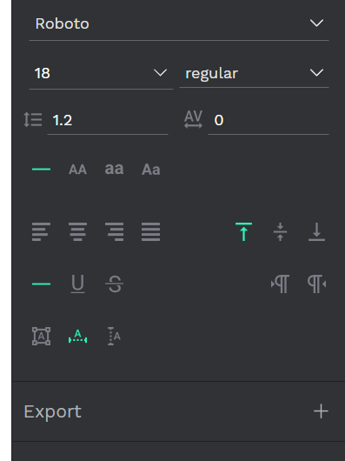
4.4 Case Practice (I)
Step7: After the button setting, is time to set up the name of the app and the attribute setting of the subtitle of the app.
Because the title must be what you want the user to see, at first sight, you must adjust the proportion of the title to be very large, and the subtitle is you If you want users to see the title after reading the title, adjust the of the subtitle to about 1/4 size of the title. The rest of the settings are the same as before.

Slide 33

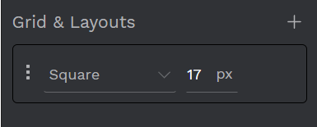
4.4 Case Practice (I)
Step8: Now is the home page wireframes setting, now create the new grid & layouts is square 17px, like the picture, then start to create the home page.

Slide 34
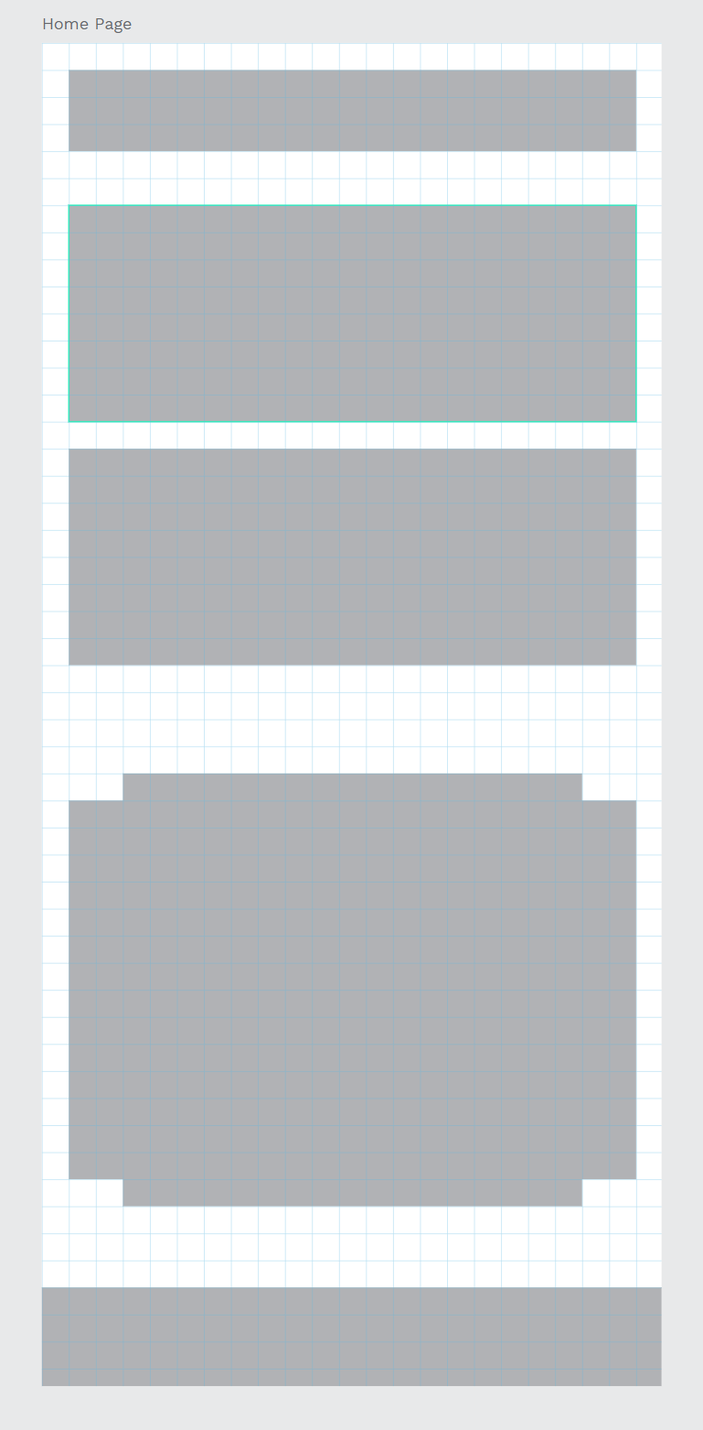

4.4 Case Practice (I)
Step9: Use the rectangle tool to create the rectangle the same as the pictures, remember to zoom in to check out the rectangle position is right on inside the square mesh or not.

Slide 35
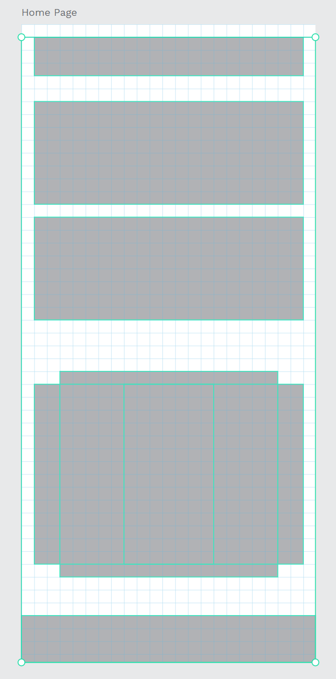
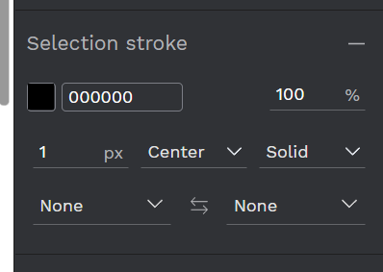
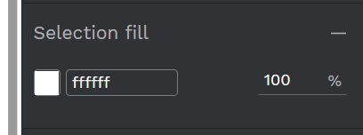
4.4 Case Practice (I)
Step10: Select all the rectangles on the artboard.
Give the properties of the rectangles, stroke, and color fill like the pictures.

Slide 36
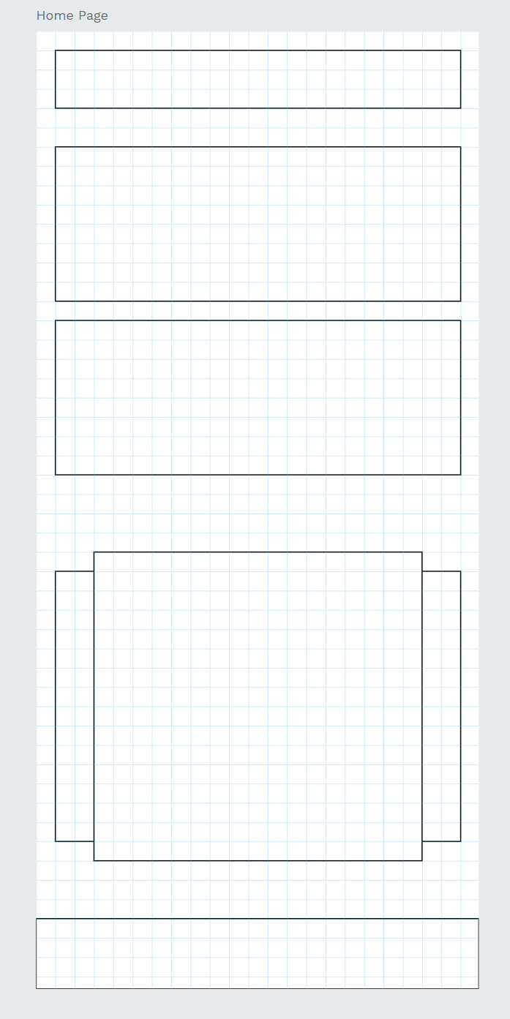
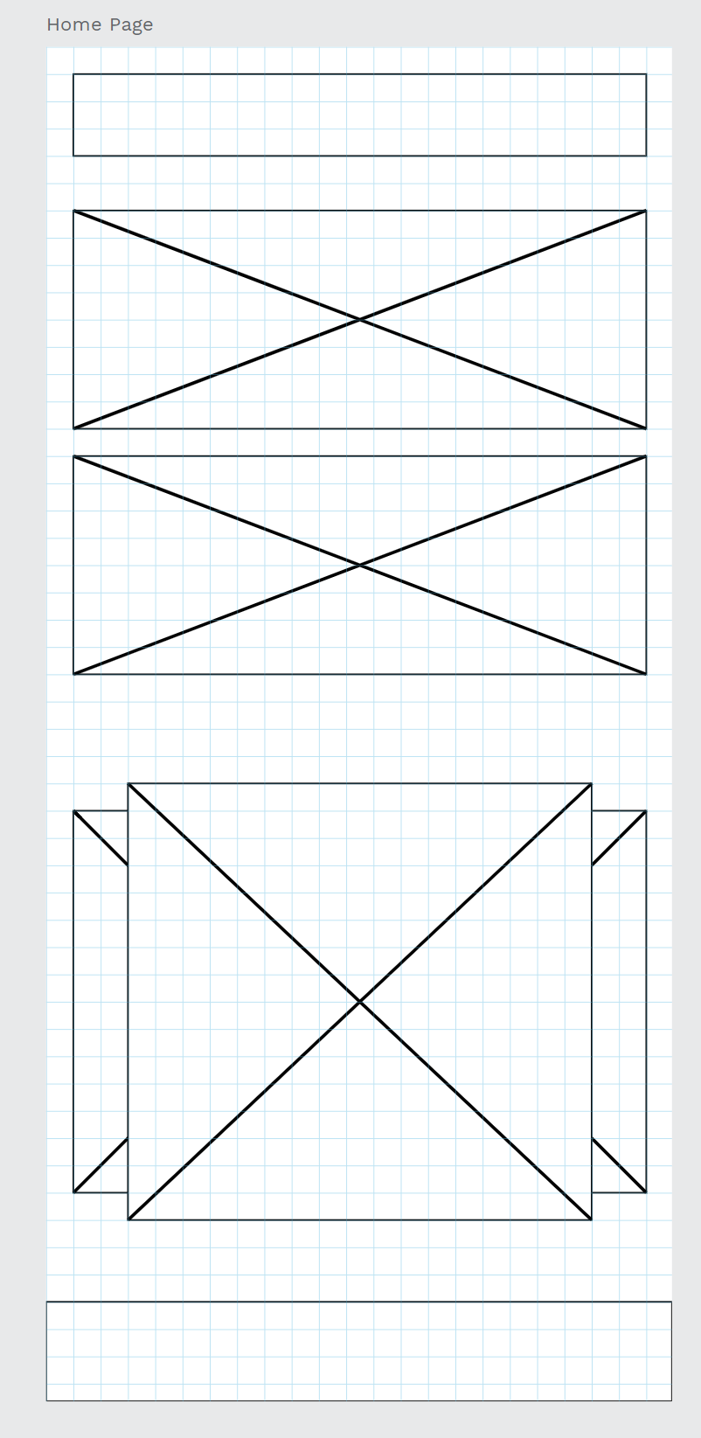
4.4 Case Practice (I)
Step11: After we give the properties of the rectangles, it will become the same as the picture.
We need to mark which rectangles are put in the photos, so we use the path tools to mark the X in the rectangles to distinguish which rectangles are for the photos.

Slide 37
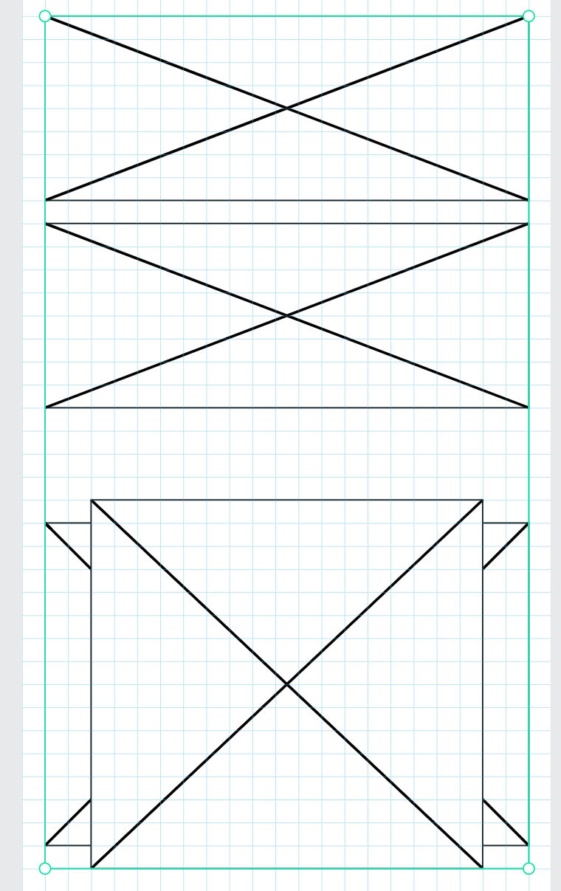
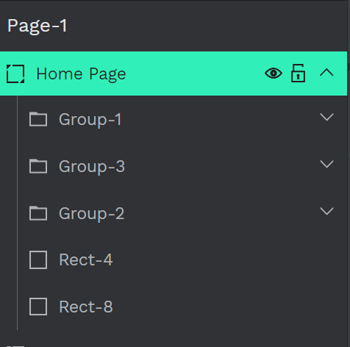
4.4 Case Practice (I)
Step12: After we created the path, the layer is will become very messy, so we need to group the corresponding path and rect together, this action will make it easier for us to manage layers without confusion.

Slide 38
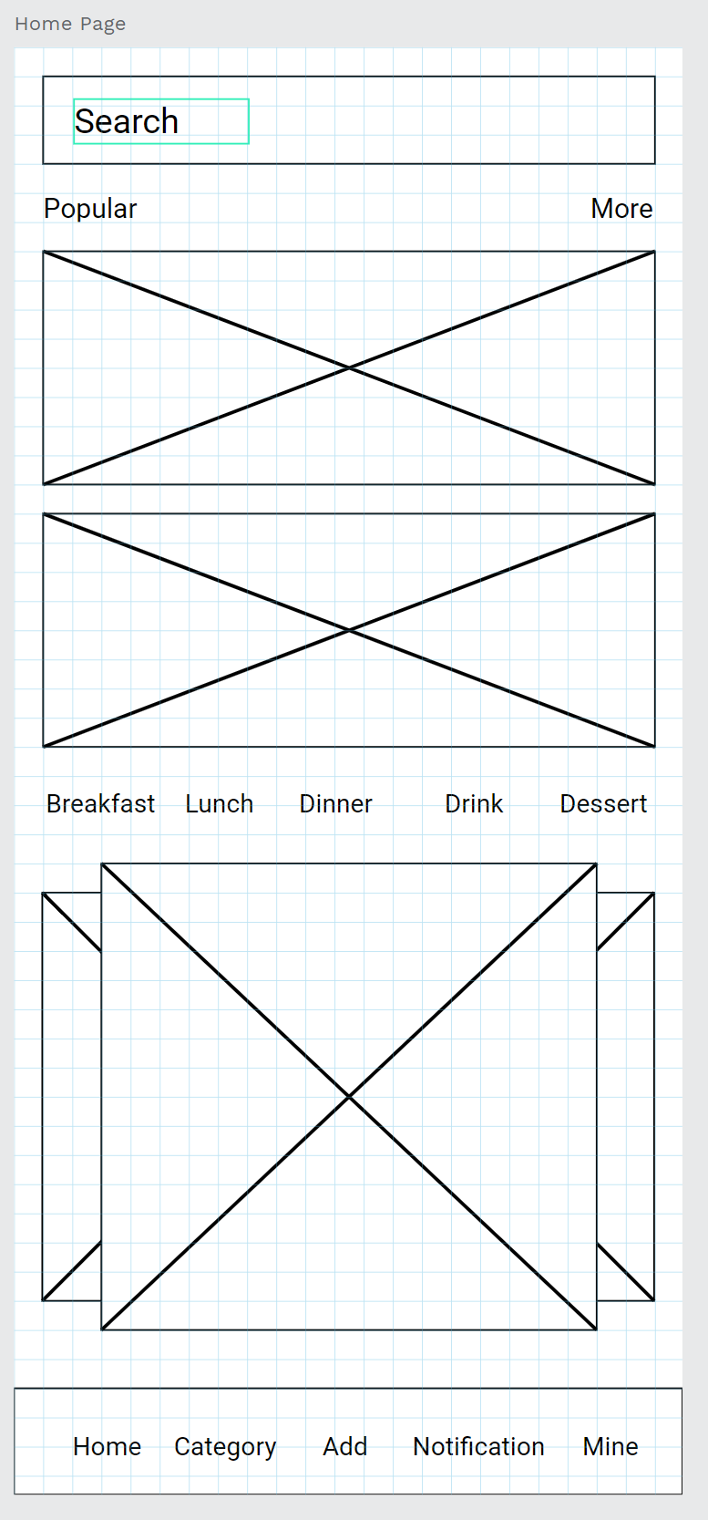
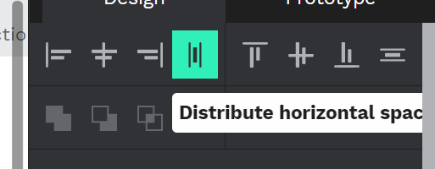
4.4 Case Practice (I)
Step13: Give homepage, the corresponding position text, such as search, popular, more, and the breakfast lunch dinner... etc, enter the home, category, add notification and mine in the lowest position. Remember to use the distribute horizontal space, to make the text is average separation, slowly to the fine-tuning position. After that group the text together.

Slide 39
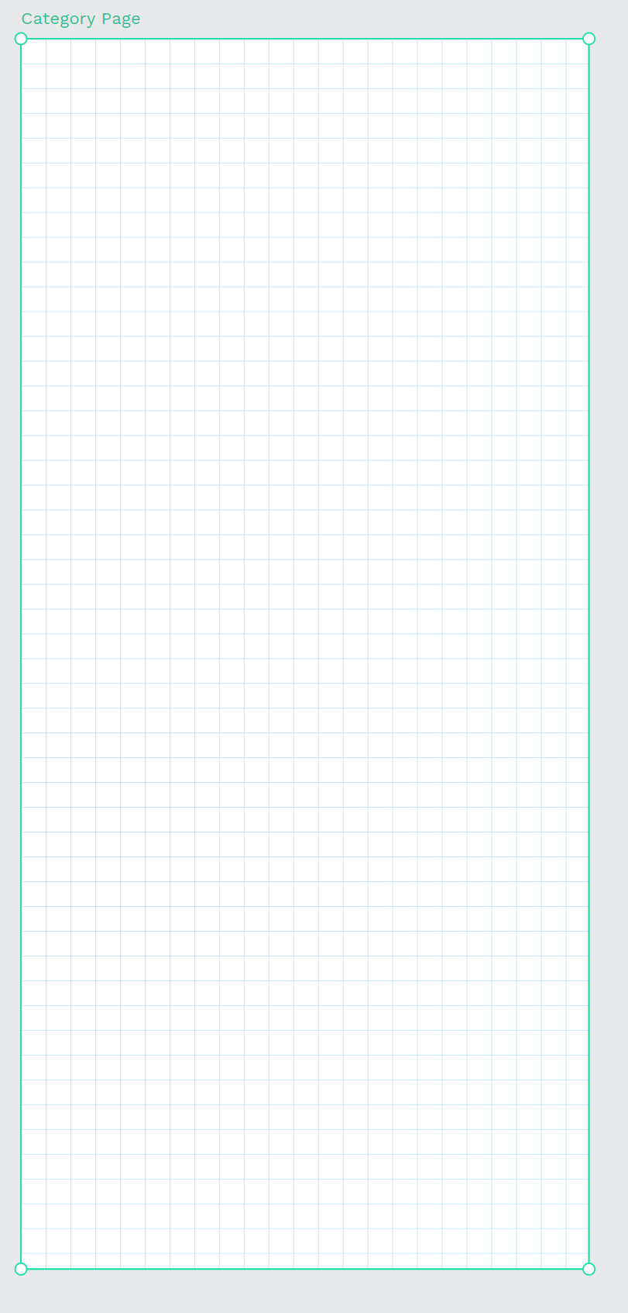
4.4 Case Practice (I)
Step14: The category is for searching some recipe page, is will have many food types to let the user search their recipe, this page needs to set to easy to look for the food type. every type of food has different photos, this is a good way to make the user know which button is for which food recipe.
The artboard setting is same as the homepage.

Slide 40
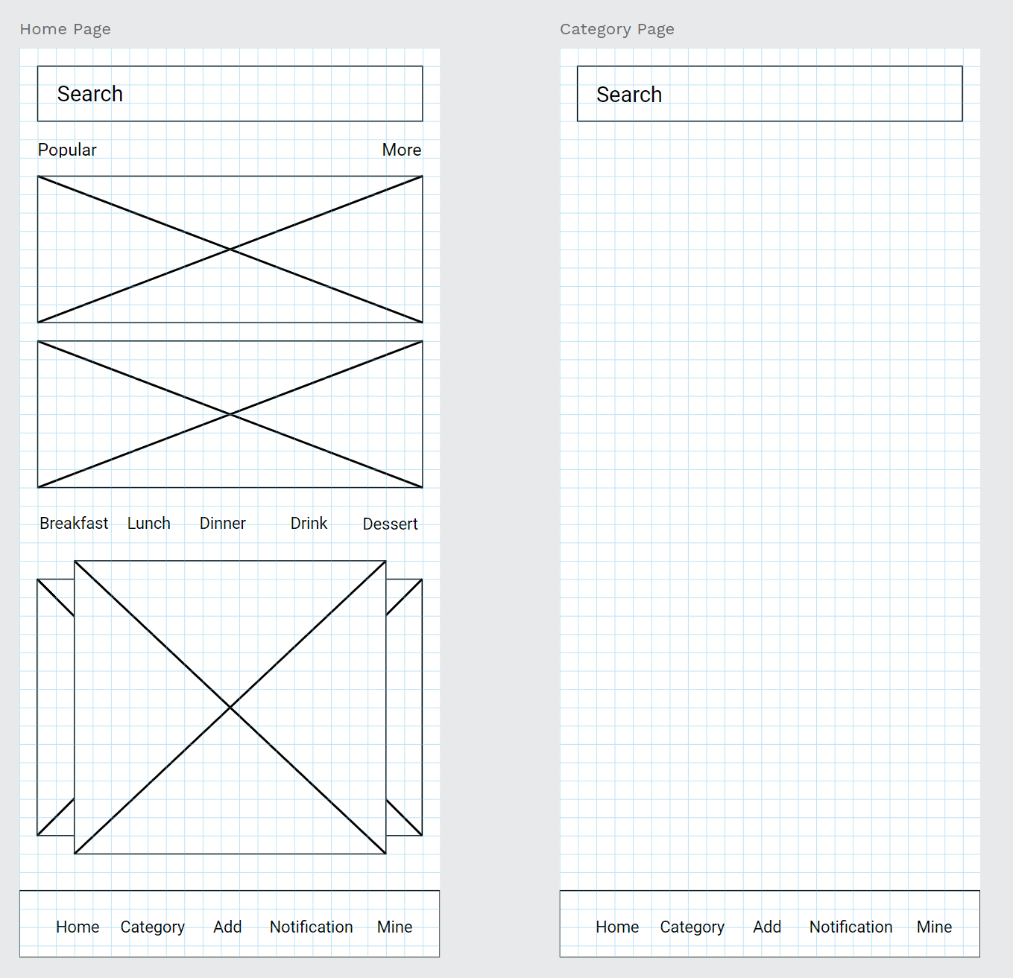
4.4 Case Practice (I)
Step15: The Search bar and the information bar are the same as the home page, so just copying and pasting into the category page is fine.
Also if every need to copy and paste is a kinda little bit slow, we can make the Search bar and the information bar become components.

Slide 41
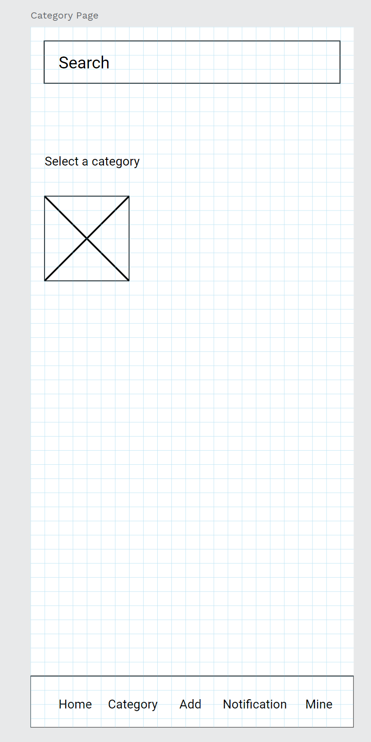
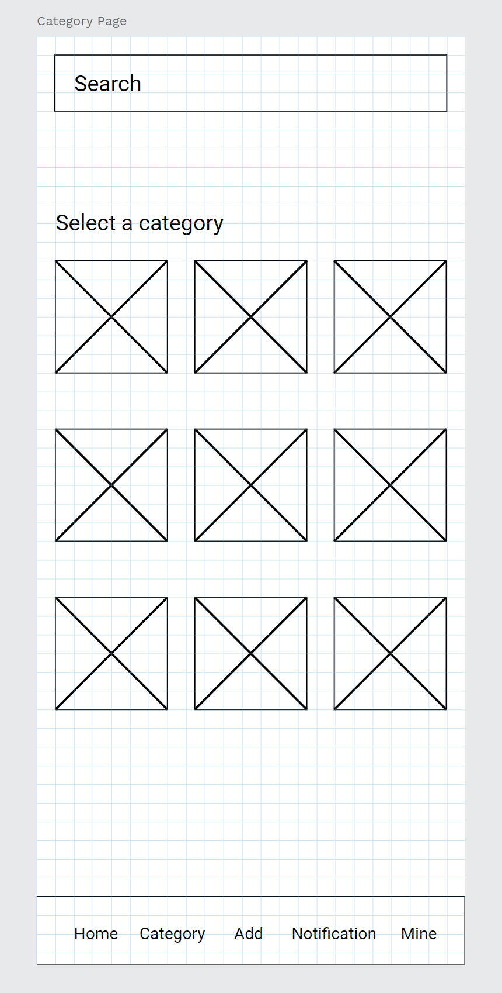
4.4 Case Practice (I)
Step16: Enter text select a category, create a rectangle and give the same properties as the home page.
After you create a rectangle, copy and paste more, and adjust the corresponding position and the text.

Slide 42
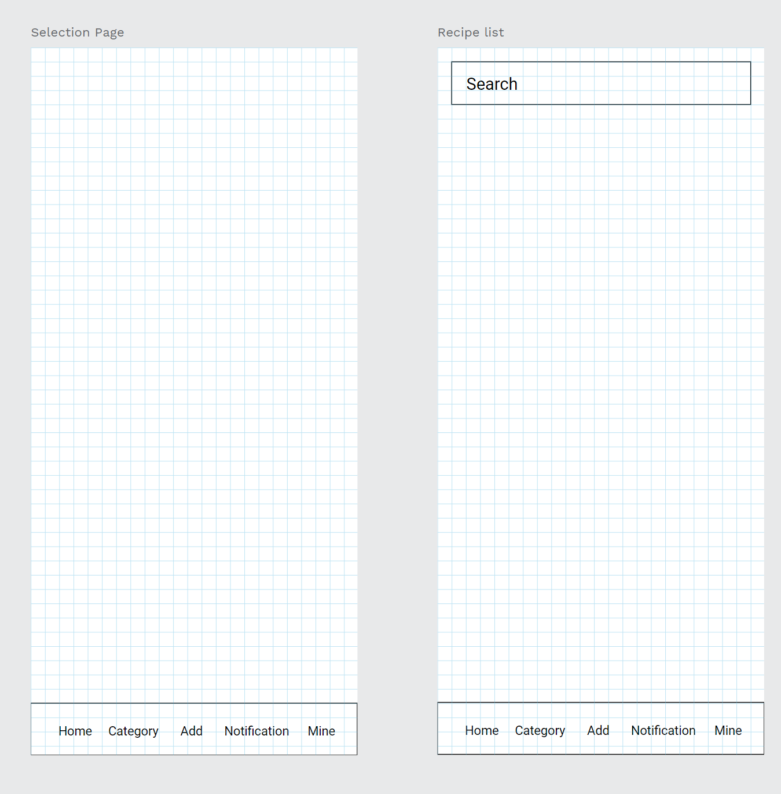
4.4 Case Practice (I)
Step17: After the Selection and Recipe-List, use the same as the methods the Previous artboards, give the gird & and layout is square 17px, search bar and the information bar to both artboards.

Slide 43

4.4 Case Practice (I)
Step18: Select the selection page, create the item info, like the photo box and the food information textbox like the picture, we can select the photo box and the textbox to be components, it will be useful for the next artboard page.
Remember fine-tuning position.

Slide 44

4.4 Case Practice (I)
Step19: Recipe list has a little bit different between the selection page, it have the hot/new button and the previous page. So we need to enter the text to make sure the button is in what position.

Slide 45

4.4 Case Practice (I)
Step20: Now after the recipe list wireframe is done, is time to create the login page and login page and sign up page wireframe, give these two artboards columns 12px layer. If you want to use a square layer is also okay too.

Slide 46

4.4 Case Practice (I)
Step21: The login page has three main important things, one is the login account, the second is the password, and the last is the login button. So far, we have created three rectangles first.
The three rectangles’ position is a little bit higher in the middle. The login button is more biggest than the two rectangles bar.

Slide 47

4.4 Case Practice (I)
Step23: In the same way, we also need to give white color to the properties of these three rectangles, and increase the stroke effect.

Slide 48



4.4 Case Practice (I)
Step24: Now enter the sign-in and log-in text, the sign-in text is in the upper position, and the login text is inside the middle of the lower button.
Sign in text size need to be more biggest to let the user know we are in the sign-in page, also the text setting also is aligned center and aligned middle.

Slide 49

4.4 Case Practice (I)
Step25: After completing the basic steps, we enter the text of the email and password in the upper left corner of the two bars, and we enter the forgot password option so that if the user forgets the password, they can press this button to reset the password.

Slide 50
4.4 Case Practice (I)
Step26: Since many additional accounts can be used to choose to log in, such as Facebook account, google account, Twitter account, etc., we add three circular icons so that users can choose the account they want to use to log in.

Slide 51

4.4 Case Practice (I)
Step27: Add a small box, and enter the remember me on the right to remember the user's account to facilitate the user's next login, and enter the text don't have an account? signup, to remind you to apply if you don't have an account, as a user guide function

Slide 52

4.4 Case Practice (I)
Step28: After completing the login page, it is the registration page. We can select the text box and input box of the text to make it a component, which will be very convenient for us to use it next.

Slide 53

4.4 Case Practice (I)
Step29: Then create the remaining four text boxes and enter bars. These five are commonly used functions for creating new accounts.
From top to bottom, they are Full name, Phone no, Email, Password and confirm password. Finally, add a new square below as a button for registering an account.

Slide 54

4.4 Case Practice (I)
Step30: Finally, we enter the corresponding text, and finally enter the words have an account? sign in as a guide for users with an account to log in to the mobile APP.
Such a wireframe of a registration screen with basic functions is completed

Slide 55

4.4 Case Practice (I)
Step31: After completing the basic steps, it's time to process the profile page and the recipe page, the content of the profile page is not too complicated, so we can use the way of columns as the layout, but the recipe page will have some content that needs to be correct, so we will use the more accurate square layer to process it.

Slide 56

4.4 Case Practice (I)
Step32: We simply create a circle for our profile avatar and a large square under the circle layer.
We simply create a circle for the profile picture and a large square under the circle layer. After that, create 5 rectangular profile items and arrange them along the border of the big square.
at last, create a small rectangular for the edit profile to use.

Slide 57

4.4 Case Practice (I)
Step33: We enter the corresponding text in each item column to distinguish what each item column is. From top to bottom are Full name, birthday, phone no, Instagram account, email, and password, and the last is edit profile.

Slide 58

4.4 Case Practice (I)
Step34: The last step is to deal with the recipe page. Generally, the recipe page can have a large picture, food name, author, food calorie, ingredient, total time, about the recipe....etc.

Slide 59

4.4 Case Practice (I)
Step35: Create rectangles on the artbroad based on the content just mentioned, simply to differentiate the position of the content.
Photo
Food name and recipe author
Calories
Total Time
About the Recipe
ingredient
Content
Cook Button

Slide 60

4.4 Case Practice (I)
Landing Page
Home Page
Category Page
Selection Page
Recipe-List
Step36: Now after we did all the steps, we will get the basic UX wireframe, that make us understand how the app flow is going.
Then we can start with the design of the UI.
Login Page
Sign up Page
Profile Page
Recipe Page

